Slide 1

Composites
Dr. J. Venkatramani
219-B
venkatramani@iiitdm.ac.in

Slide 2
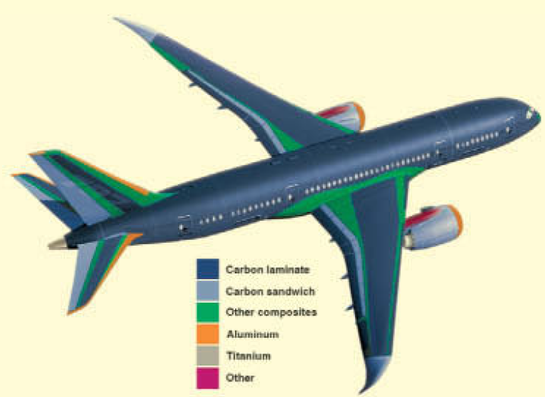

Slide 3
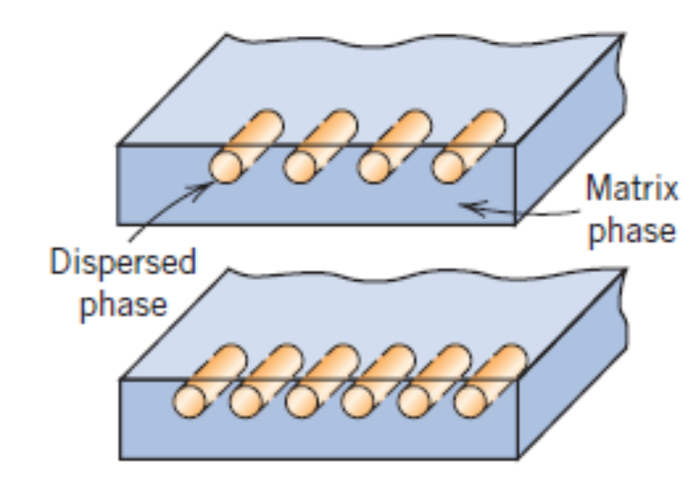
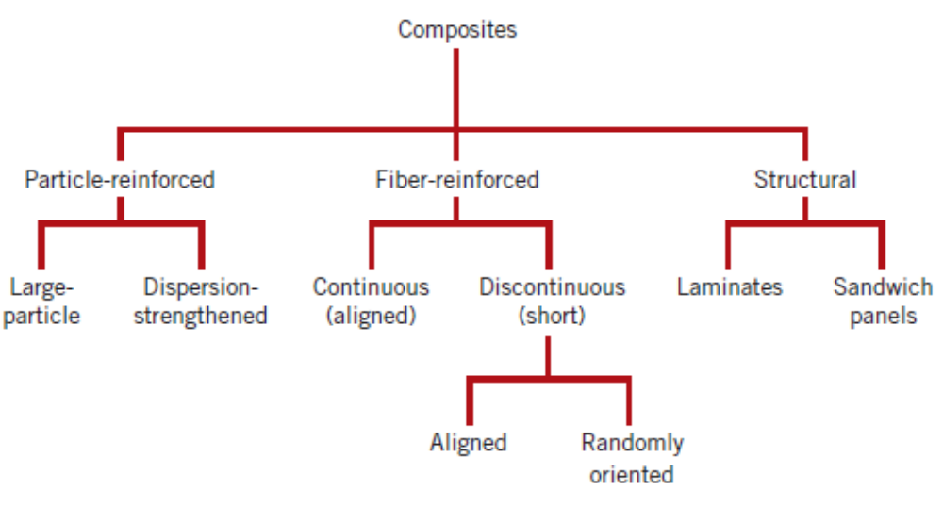
Composites
What is a composite? A multi – phase material?
ANS: True
How is it different from a two – phase (or multi – phase) alloy?
ANS: Multiphase alloys form naturally; their composition is decided by the phase diagram. Secondly, they are of same chemical form.

Slide 4
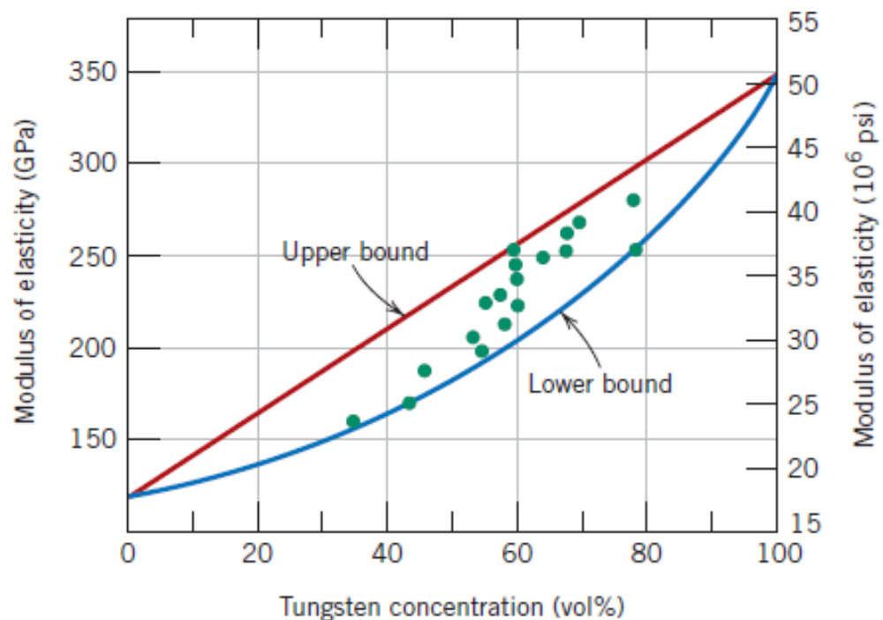
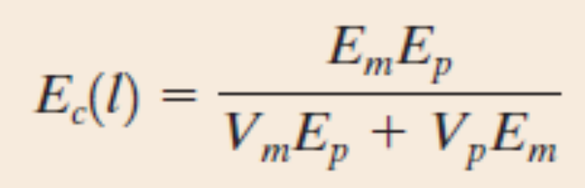
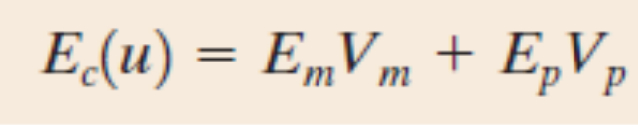
Particle–Reinforced Composites
Large – particle and
Dispersion – strengthened
Concrete – cement as matrix, sand and gravel as particulates
Polymer composites
Tungsten particles in Cu

Slide 5
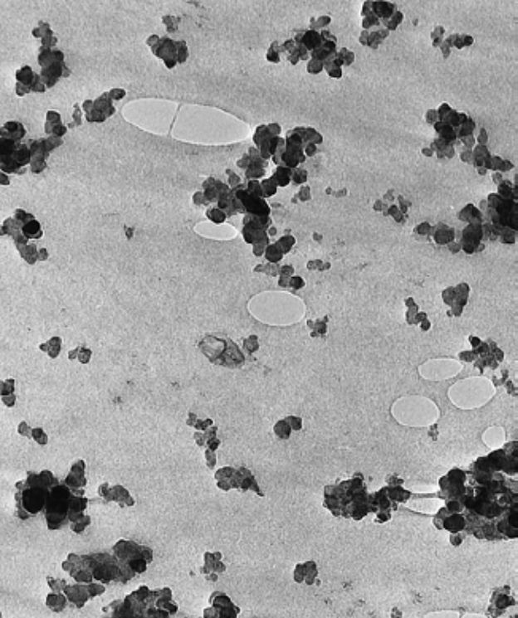
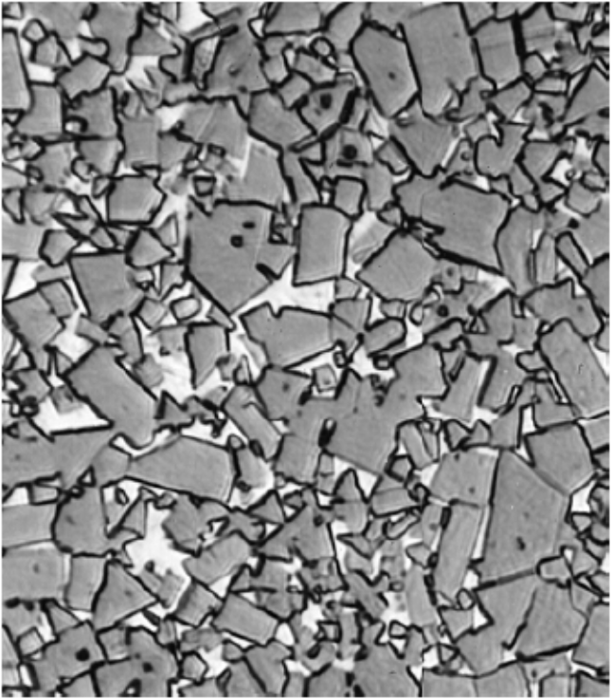
Particle–Reinforced Composites
Tungsten Carbide–Co composite
Carbon black in synthetic rubber
Other large particle reinforced composites are concrete – Portland cement concrete, reinforced concrete
Asphaltic concrete is used for pavements. Portland cement concrete is used for buildings.
Reinforced concrete involves additional reinforcement in the form of steel wires, rods, bars within the uncured concrete.

Slide 6
Dispersion Strengthened Composites
Metals and metal alloys are reinforced with very fine particles of either metallic or non – metallic materials.
The strengthening mechanism is same as that of precipitation and solid solution strengthening.
The strengthening capability, although is lesser for these composites compared to precipitation hardened alloys, the composites can retain their property even at higher temperatures. This is because the reinforcing particles are chosen to be reactive with matrix and does not cause any heat treatment.
Examples: Thoria (ThO₂) – dispersed Nickel; Al – Al₂O₃ system
Normal synthesis routes – friction stir welding, stir casting, novel additive manufacturing techniques

Slide 7
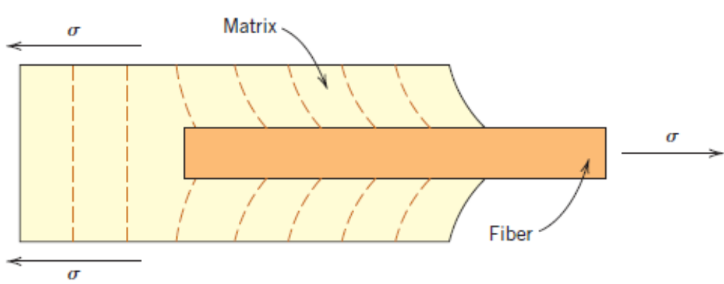
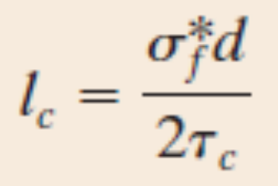
Fibre Reinforced Composites
Classified based on fibre length.
Characterized using strength per unit weight and/or stiffness per unit weight–specific strength, specific stiffness.
Critical length of the fibre for load transmittance.
Critical fibre length in Glass and fibre reinforced composites is about 1 mm.

Slide 8
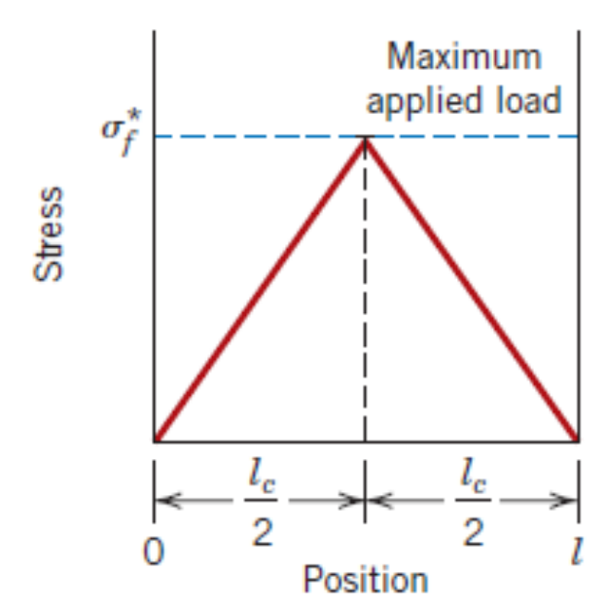
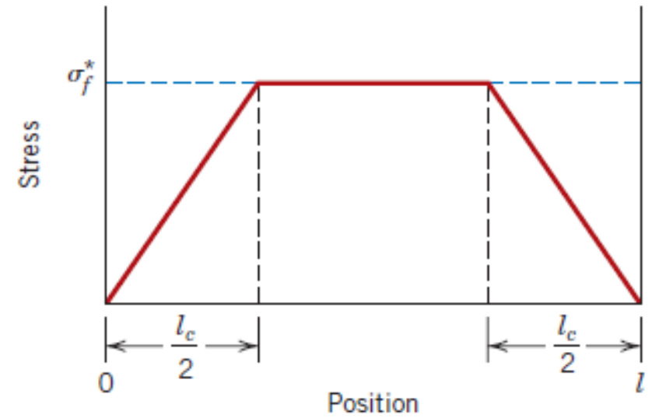
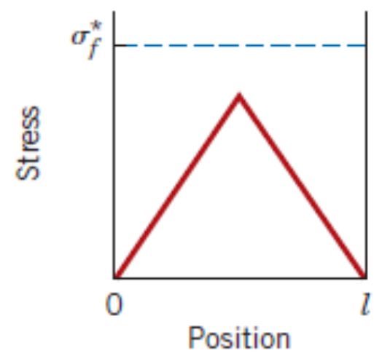
Fibre Reinforced Composites
Stress distribution along a fibre of length l > l_{c}.
Stress distribution along a fibre of length l < l_{c}.
Stress distribution along a fibre of length l = l_{c}.
Fibres of length l > 15l_{c} are called continuous. Discontinuous and short fibres are the ones whose lengths are shorter than this.

Slide 9
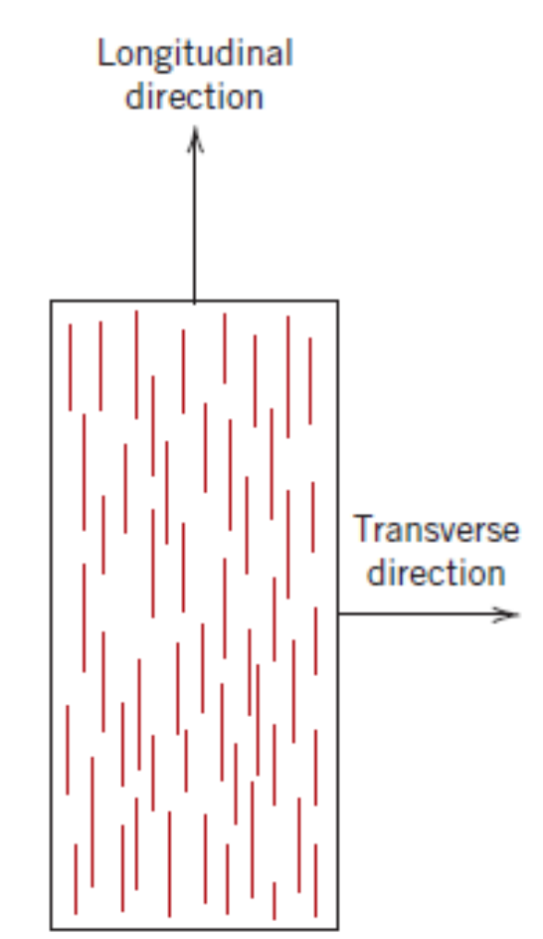
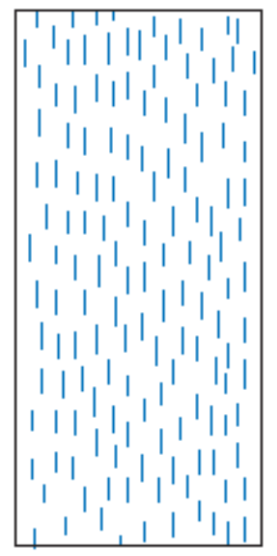
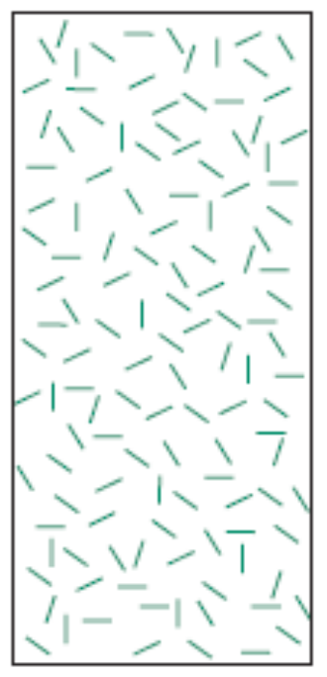
Fibre Reinforced Composites
Another important factor that governs the strength of a fibre reinforced composite is the fibre orientation.
Continuous fibres are normally aligned. Short fibres can be random or aligned.
Long fibre aligned arrangement
Short fibre aligned arrangement
Short fibre random arrangement

Slide 10
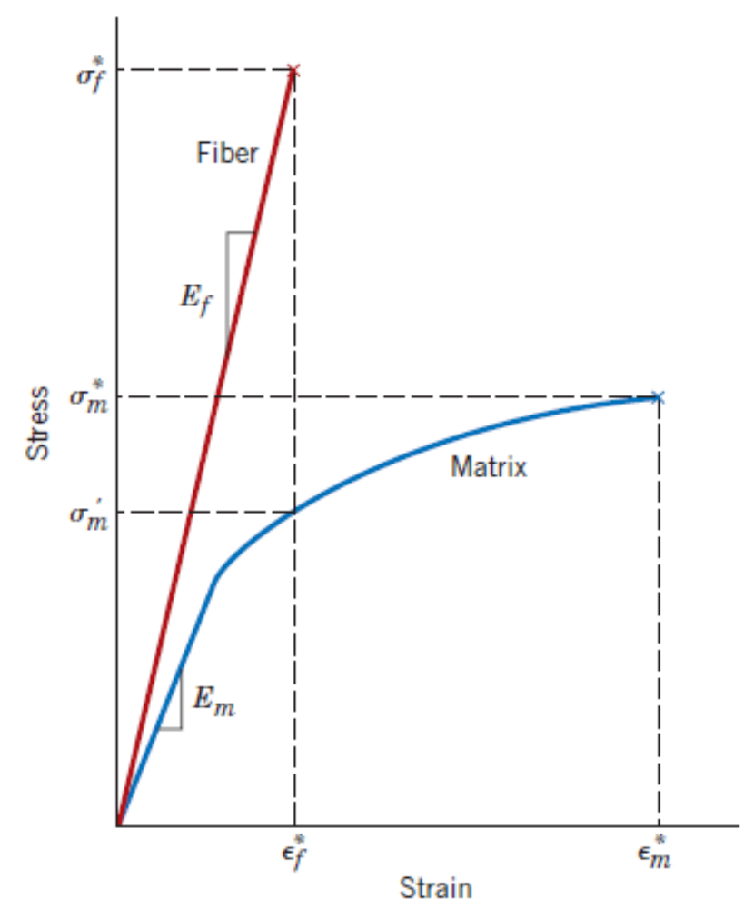
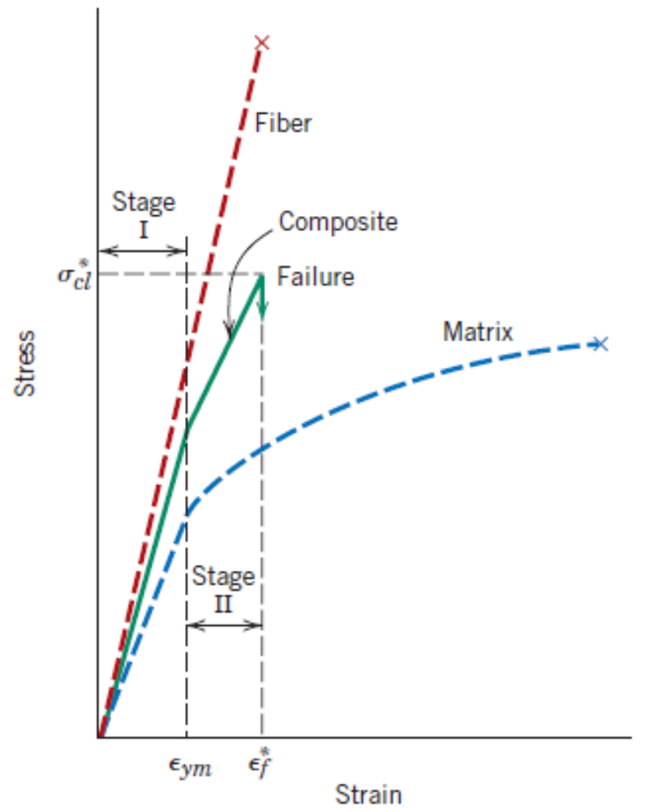
Mechanical Response of Continuous fibre composite

Slide 11
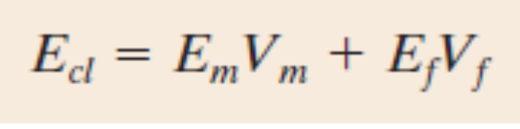
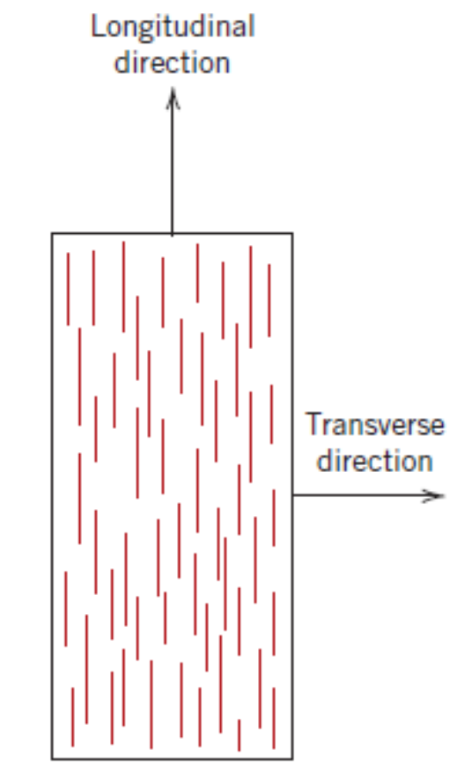
Elastic Behaviour in Longitudinal Loading
Let A_{m}, A_{f} and A_{c} be the area of cross – section of the matrix, fibre and composite. Let F_{c} be the net force applied in the longitudinal direction.
F_{c}
F_{c}
F_{f}
Net force F_{m} in the matrix
Free body diagram
F_{c}

Slide 12
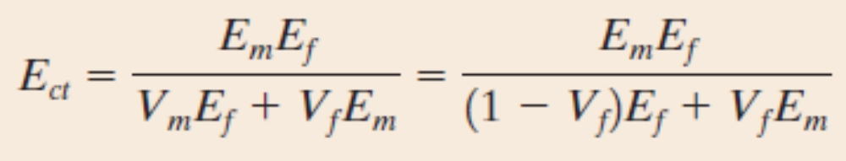
Elastic Behaviour in Transverse Loading
Let A_{m}, A_{f} and A_{c} be the area of cross – section of the matrix, fibre and composite. Let F_{c} be the net force applied in the longitudinal direction.
Free body diagram?
F_{c}
F_{c}

Slide 13
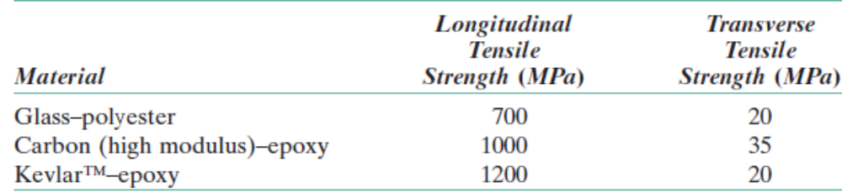
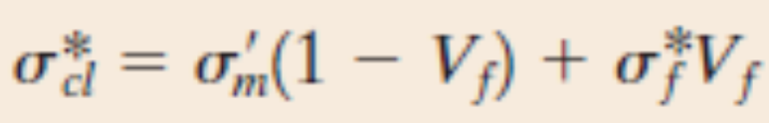
Tensile Strength of Continuous Aligned Composites

Slide 14
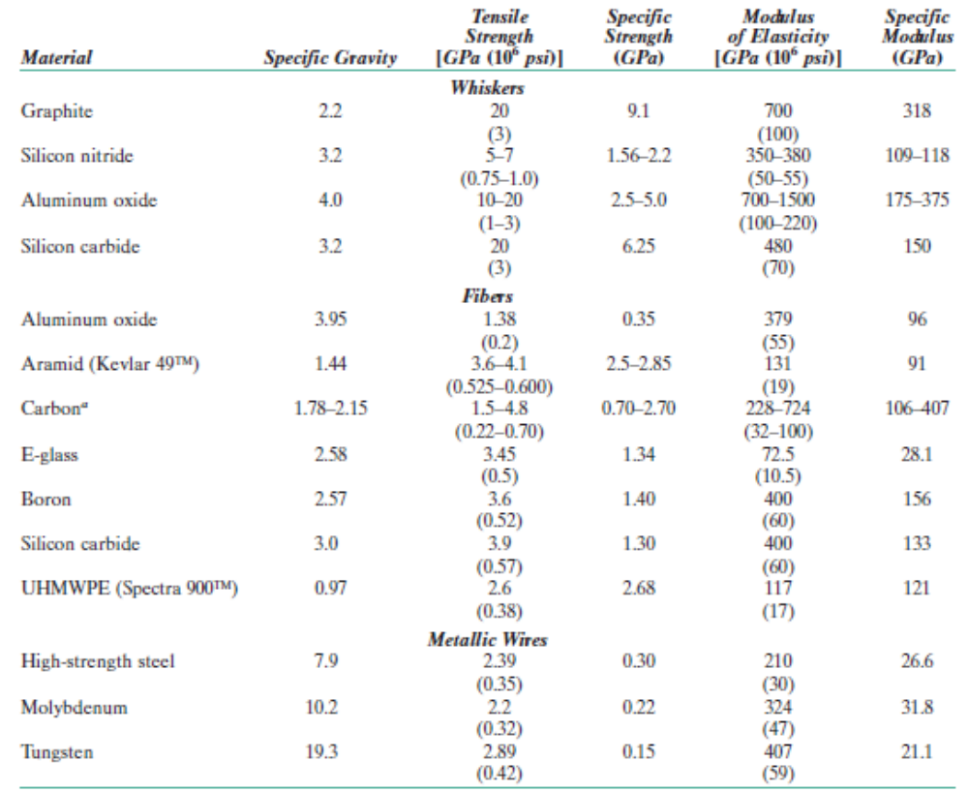
Fiber Phase – Discontinuous or Short Fibre Reinforced Composites

Slide 15
Matrix Phase
Matrix materials can be metals, ceramics or polymers.
Requirements:
  Ductile and soft so that the cracks do not propagate fast from fibre to fibre.
  Should be able to bind the fibres well in order to transfer the applied load.
  Protect the fibres from harsh chemical environment and mechanical abrasion.
Adhesive bonding between matrix and fiber is the most important factor in order to minimize fiber pull–out.

Slide 16
Matrix Phase
Polymer matrix composites
  Glass Fiber Reinforced Composites (GFRP) – storage containers, plastic pipes, automotive & marine
  Carbon Fiber Reinforced Composites (CFRP) – golf clubs, fishing rods, pressure vessels
  Aramid Fiber Reinforced Composites – poly (paraphenylene terephthalamide)

Slide 17
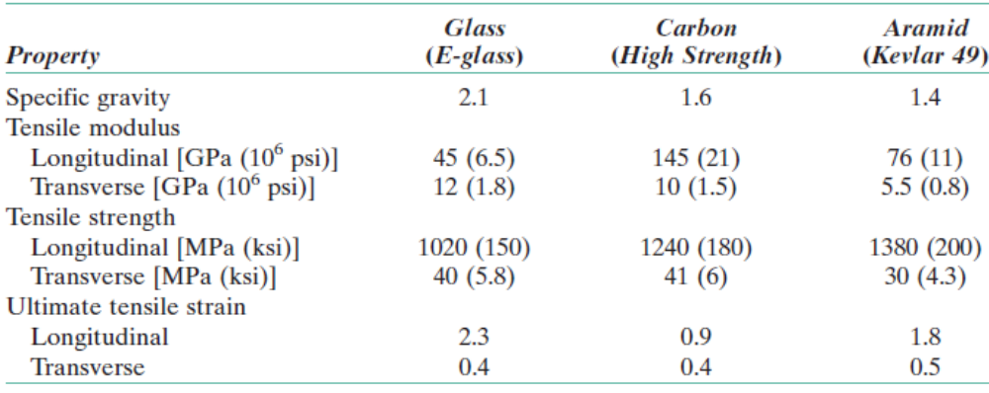
Matrix Phase
Polymer matrix composites
  Glass Fiber Reinforced Composites (GFRP) – storage containers, plastic pipes, automotive & marine
  Carbon Fiber Reinforced Composites (CFRP) – golf clubs, fishing rods, pressure vessels
  Aramid Fiber Reinforced Composites – poly (paraphenylene terephthalamide)

Slide 18
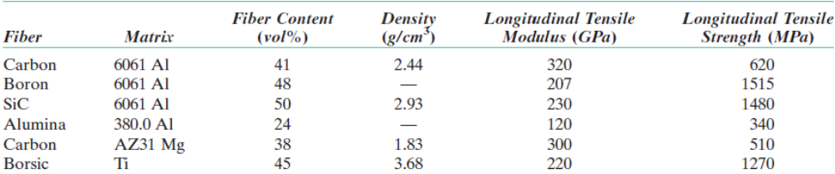
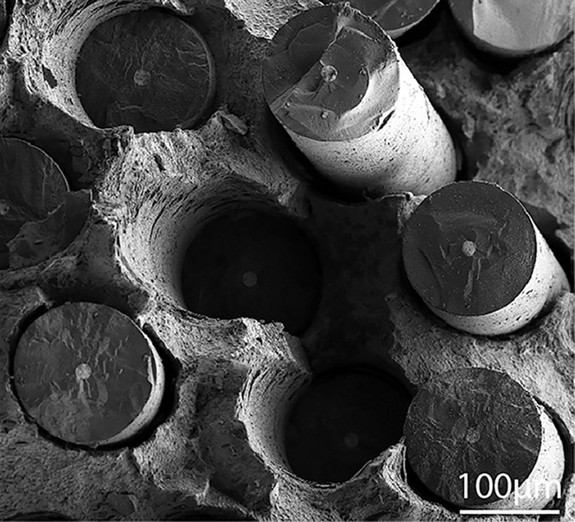
Metal – Matrix Composites
Expensive than PMC
Suitable for high temperature applications
SiC particles in Ti

Slide 19
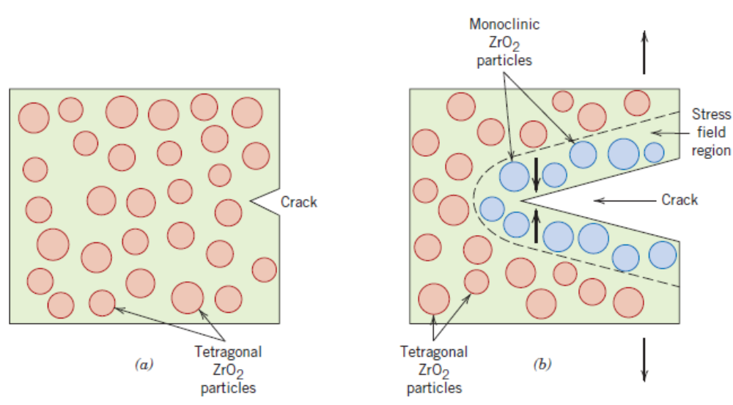
Ceramic – Matrix Composites
Ceramic particles in another ceramic.
Transformation toughening

Slide 20
Other Matrix Materials for Composites
Carbon – Carbon Composite
Hybrid Composites

Slide 21
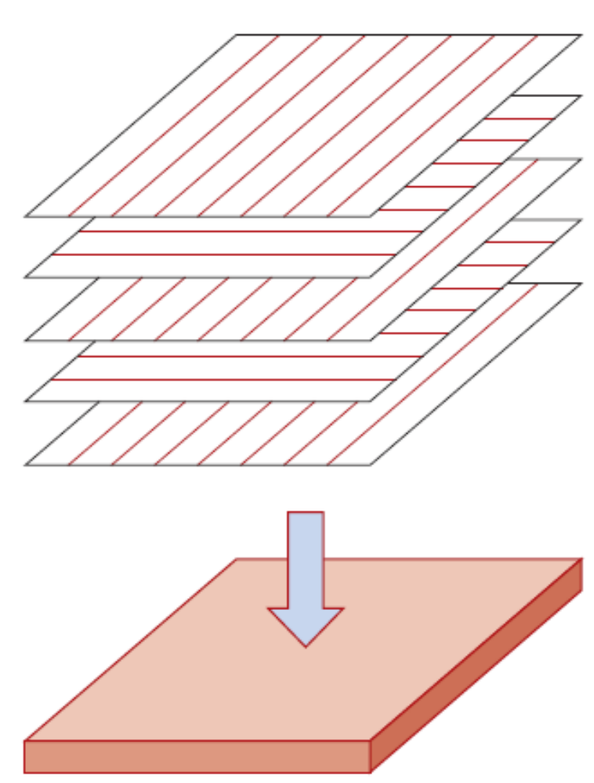
Structural Composites
Laminar composite

Slide 22
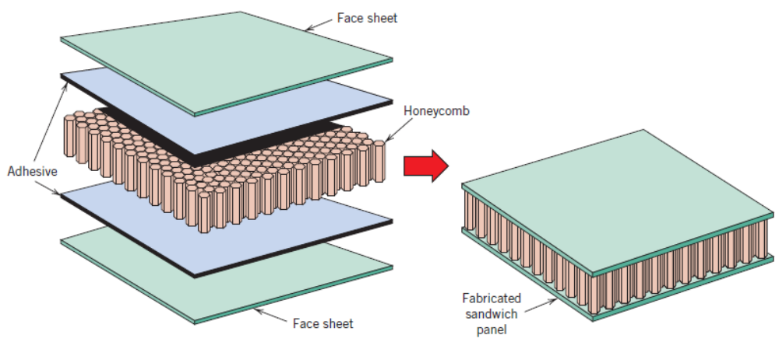
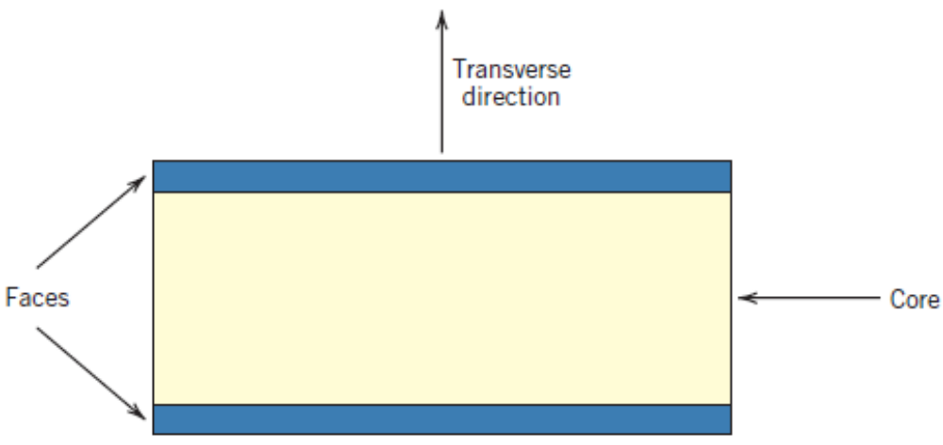
Structural Composites
Sandwich panels

Slide 23
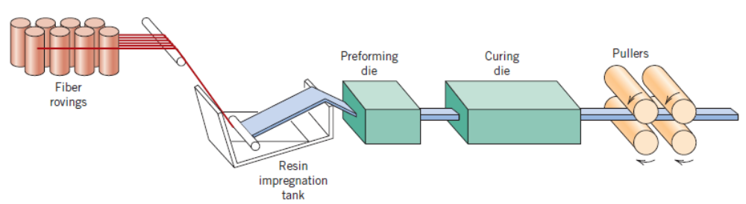
Processing of Composites – Pultrusion technique

Slide 24
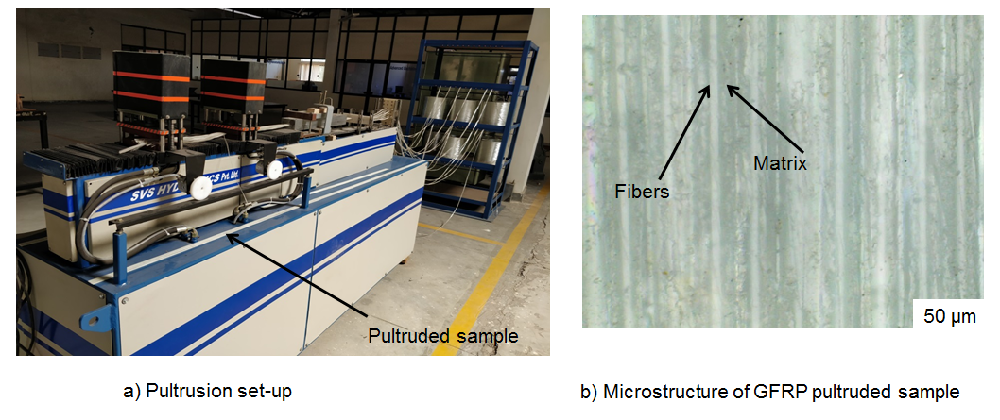
A Pultrusion setup at BITS Hyderabad

Slide 25
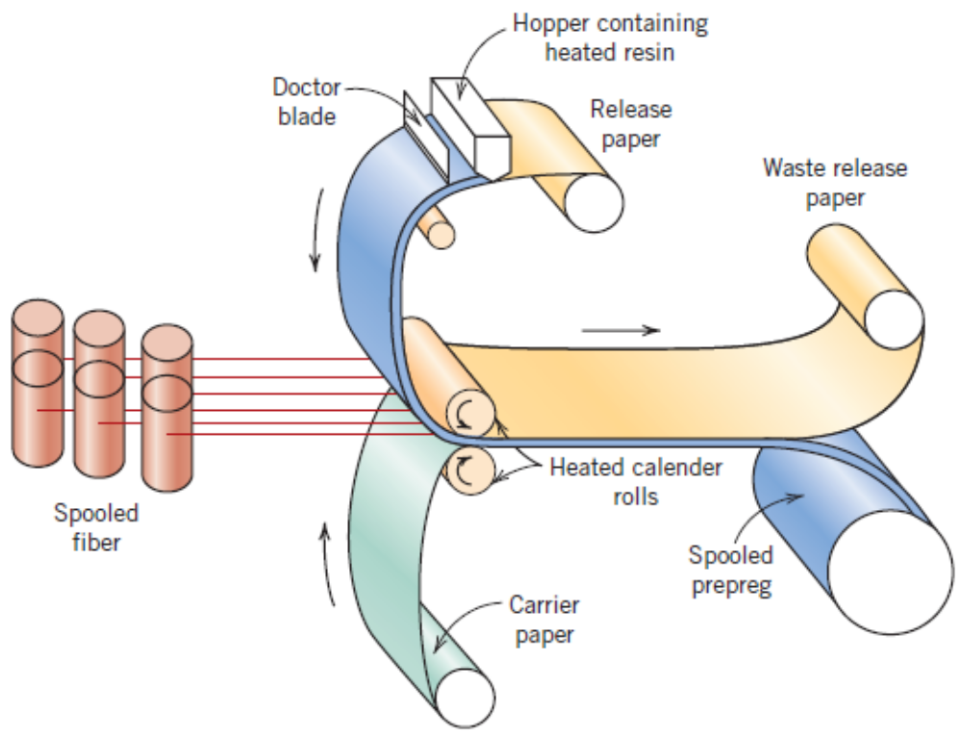
Processing of Composites – Prepreg Production Process

Slide 26
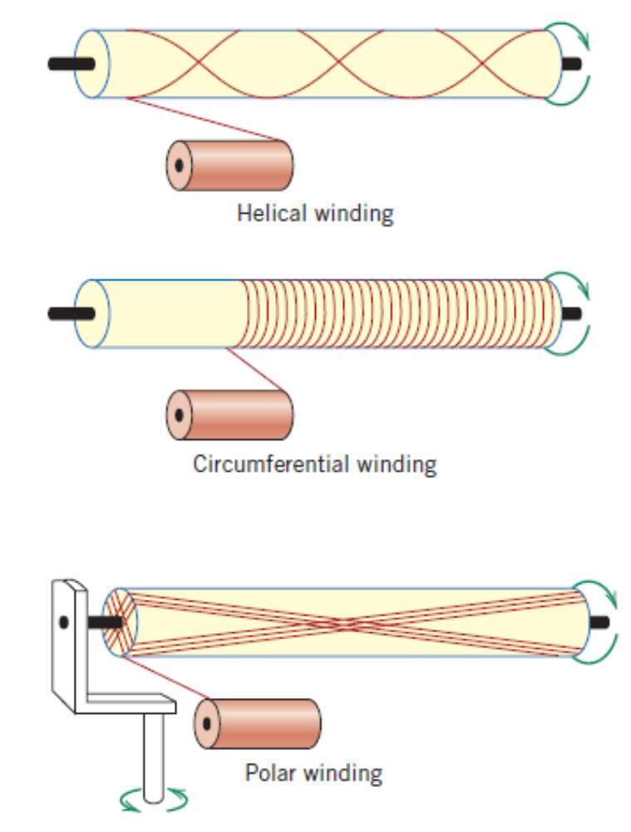
Processing of Composites – Filament Winding Technique

